Slide 1
Introduction to Biostatistics
Basic Concepts of Data and Statistics
1 - Basic Concepts of Data and Statistics

Slide 2
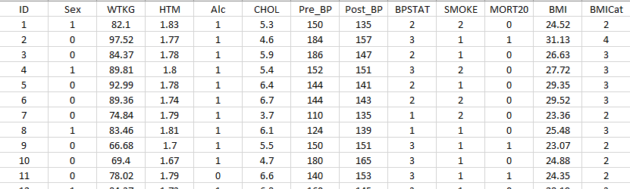
What does “Data” mean?
A set of Observations (Cases) (who?)
A set of Variables (Attributes, Measurements, …) (what?)

Slide 3
Variables
Attributes or Measurements of our Research Interest
To Categorise
To Measure
To Count
To Rank

Slide 4
Type of Variables
A Comparative Description
Qualitative or Quantitative
Categorical or Numerical
Discrete or Continuous

Slide 5
Type of Variables
Same terms are used in various software packages
Nominal (Labels) - Gender, Marital Status, Pass/Fail, Batch Number
Ordinal (Ranks) – Age Groups, Social Class, General Health Status, Quality level
Interval or Ratio (Measures) - Age, Height, Weight, Survival time, Temperature
Ratio: Zero means “zero” !
Interval: Zero does not mean “zero” !

Slide 6
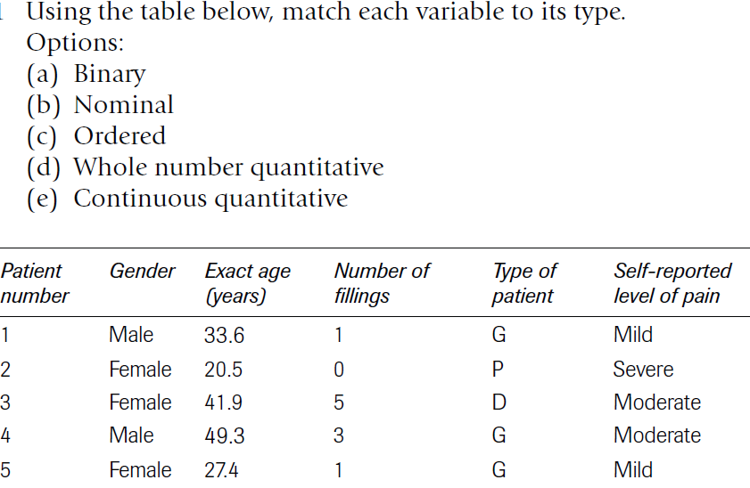
Type of Variables
Test Your Understanding

Slide 7
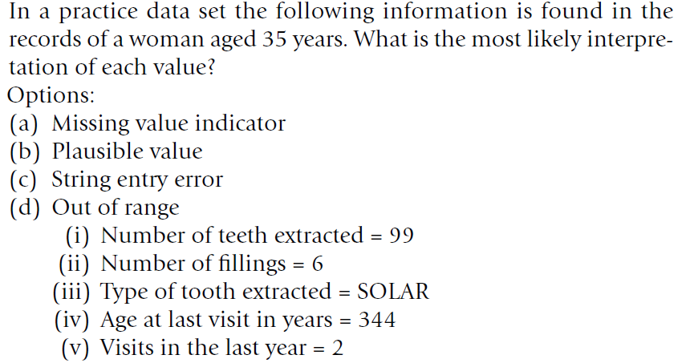
Type of Variables
Test Your Understanding

Slide 8
Data Management and Associated Considerations
What are the main variables of interest?
Understanding the Research Questions/Primary and Secondary outcomes
Clear definition of variables
Study population and sample
Data collection tools
Data Dictionary

Slide 9
What is Encompassed by (Bio)statistics?
Descriptive Statistics: To Describe and Visualize the Data using Frequency Tables, Mean, Median, IQR, StD
Probability: To understand and quantify “Uncertainty” associated with Statistical Inference
Inferential Statistics: To generalize the results from “Sample” to “Population”

Slide 10
How to Learn Biostatistics?
What type of questions to ask yourself?
3 Type of questions should be answered in Statistics:
What?
Why?
How?

Slide 11
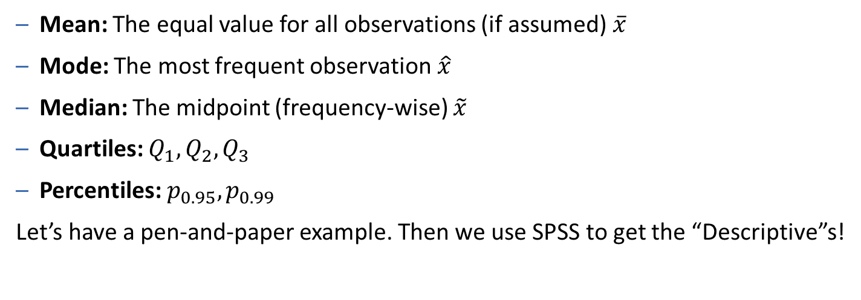
Elements of Descriptive Statistics
Measures of Central Tendency
Mean: The equal value for all observations (if assumed) $\overline{x}$
Mode: The most frequent observation $\hat{x}$
Median: The midpoint (frequency-wise) $\tilde{x}$
Quartiles: $Q_{1},Q_{2},Q_{3}$
Percentiles: $p_{0.95}, p_{0.99}$
Let’s have a pen-and-paper example. Then we use SPSS to get the “Descriptive”s!

Slide 12
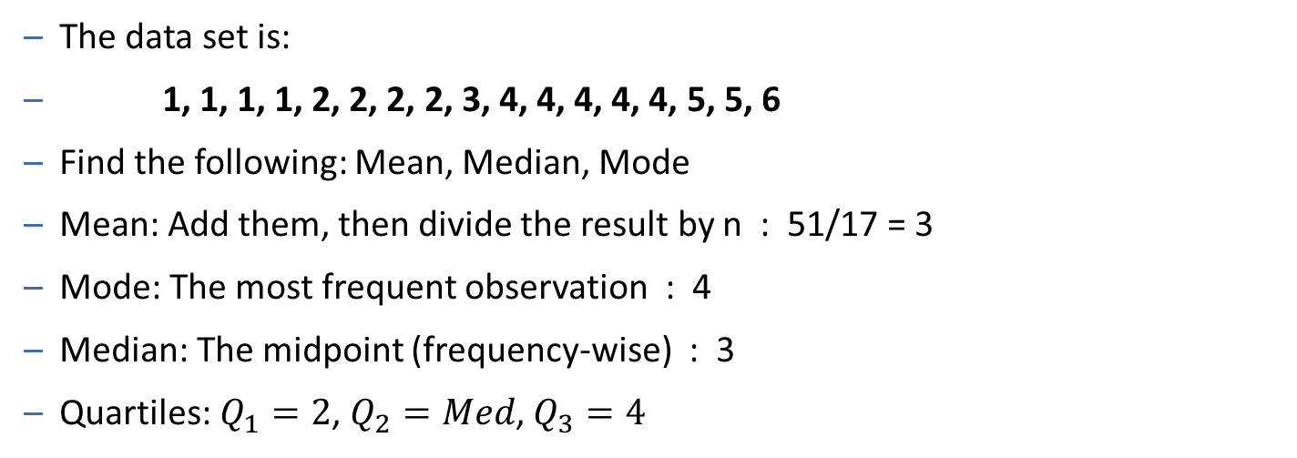
Elements of Descriptive Statistics
Measures of Central Tendency
The data set is:
1, 1, 1, 1, 2, 2, 2, 2, 3, 4, 4, 4, 4, 4, 5, 5, 6
Find the following: Mean, Median, Mode
Mean: Add them, then divide the result by n : 51/17 = 3
Mode: The most frequent observation : 4
Median: The midpoint (frequency-wise) : 3
Quartiles: $Q_{1}=2$, $Q_{2}=Med$, $Q_{3}=4$

Slide 13
Elements of Descriptive Statistics
A Simple Example
The data set is:
1, 2, 3, 4, 5
Find the following: Mean, Median
Now the data set is:
1, 2, 3, 4, 100
Find the following again: Mean, Median
RESULT: “Median” is a more “Robust” measure than “Mean”.

Slide 14
Elements of Descriptive Statistics
Measures of Dispersion
What? Variance, Standard Deviation, Coefficient of Variation, IQR
Why? (See the example below)
Student 1: 40, 50, 50, 50, 60
Student 2: 20, 50, 50, 50, 80
Find the following: Mean, Median, Mode
So what?

Slide 15
Elements of Descriptive Statistics
Measures of Dispersion
Now, plot your data!
40 50 60
20 50 80

Slide 16

Elements of Descriptive Statistics
Measures of Dispersion
Variance
How?
Student 1: 40, 50, 50, 50, 60
Student 2: 20, 50, 50, 50, 80
So?
$$Var= S^{2}= \frac{1}{n−1} \sum{{\left(x−\overline{x}\right)}^{2}}$$
$$S_{1}^{2}= \frac{1}{5−1} \left[{\left(40−50\right)}^{2}+ {\left(50−50\right)}^{2}+{\left(50−50\right)}^{2}+{\left(50−50\right)}^{2}+{\left(60−50\right)}^{2}\right]= 50$$
$$S_{2}^{2}= \frac{1}{5−1} \left[{\left(20−50\right)}^{2}+ {\left(50−50\right)}^{2}+{\left(50−50\right)}^{2}+{\left(50−50\right)}^{2}+{\left(80−50\right)}^{2}\right]= 450$$

Slide 17

Elements of Descriptive Statistics
Measures of Dispersion
Standard Deviation
How?
Student 1: 40, 50, 50, 50, 60
Student 2: 20, 50, 50, 50, 80
$$SD= \sqrt{Var}=S= \sqrt{\frac{1}{n−1} \sum{{\left(x−\overline{x}\right)}^{2}}}$$
$$S_{1}= \sqrt{50}$$
$$S_{2}= \sqrt{450}$$

Slide 18


Elements of Descriptive Statistics
Measures of Dispersion
Coefficient of Variation
How?
Student 1: 40, 50, 50, 50, 60
Student 2: 20, 50, 50, 50, 80
$$CV=\frac{SD}{\overline{x}}×100\%$$
$${CV}_{1}= \frac{\sqrt{50}}{50}×100\%=14\%$$
$${CV}_{2}= \frac{\sqrt{450}}{50}×100\%=42\%$$

Slide 19
Statistical Tools of Studying two (or more) Variables
Regression Analysis
Regression analysis is a mathematical/statistical tool to build a model that describes the relationship between two (or more) variables.
Regression analysis allows us to model the variation of a statistical variable (response/dependent variable) vs. other variable(s) (estimator/independent variable).

Slide 20
Statistical Tools of Studying two (or more) Variables
Regression Analysis
Regression analysis is a mathematical/statistical tool to build a model that describes the relationship between two (or more) variables.
Regression analysis allows us to model the variation of a statistical variable (response/dependent variable) vs. other variable(s) (estimator/independent variable).
Regression analysis is used to estimate/predict the response for different values of the independent variable, based on previously gathered data.

Slide 21
Statistical Tools of Studying two (or more) Variables
Regression Analysis
A couple of general examples
Weekly expenditure (response) & weekly income (estimator)
Mean wage (response) & years of schooling (estimator)
Amount of agriculture product in kg (response) & amount of rain in mm (estimator)
Blood sugar level (response) & weight (estimator)

Slide 22
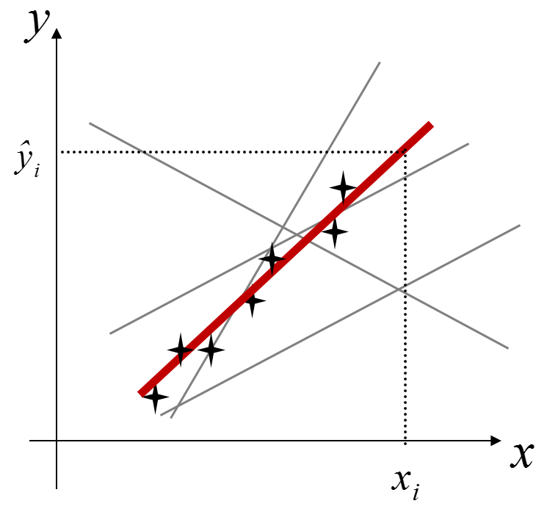
Statistical Tools of Studying two (or more) Variables
Regression Analysis – Graphical Illustration

Slide 23
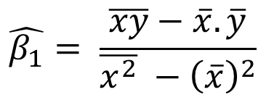

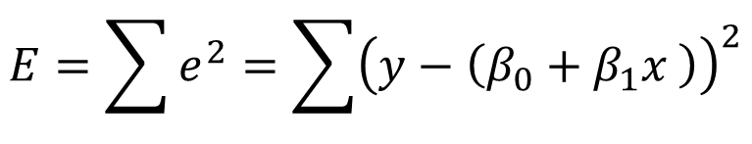

Statistical Tools of Studying two (or more) Variables
23
Regression Analysis – Mathematical Logic and Formulation
$$\hat{y}=β_{0}+β_{1}x$$
$$E=\sum{e^{2}}=\sum{{\left(y−\left(β_{0}+β_{1}x \right)\right)}^{2}}$$
$$\hat{β_{1}}= \frac{\overline{xy}−\overline{x}.\overline{y}}{\overline{x^{2}} −{\left(\overline{x}\right)}^{2}}$$
$$\hat{β_{0}}= \overline{y} −\hat{β_{1}}\overline{x}$$

Slide 24

Statistical Tools of Studying two (or more) Variables
Regression Analysis – Numerical Example
$$\hat{β_{0}}=0.4 , \hat{β_{1}}=2$$

Slide 25
Statistical Tools of Studying two (or more) Variables
25
Correlation Analysis – Graphical Illustration
Correlation coefficient is an index of strength of relationship between X and Y.

Slide 26
Statistical Tools of Studying two (or more) Variables
26
Correlation Analysis – Mathematical Formula (well, one of them!)

Slide 27
Statistical Tools of Studying two (or more) Variables
27
27
Correlation Analysis – Further Graphical Illustration

Slide 28
Statistical Tools of Studying two (or more) Variables
28
Correlation Analysis – Numerical Example

Slide 29
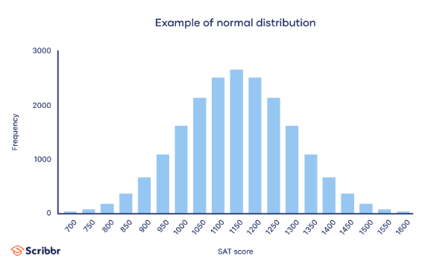
Normal Distribution
The figure below shows the empirical frequency of SAT, that looks like a Normal distribution.
Normal distribution is a “symmetric” distribution in which: Mean=Median=Mode
The term “symmetric” indicates that the figures with same proximity in both side of mean have the same frequency (probability).

Slide 30
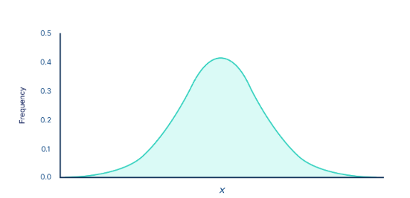
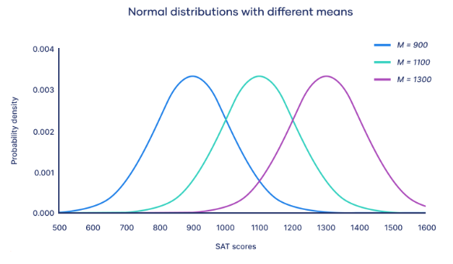
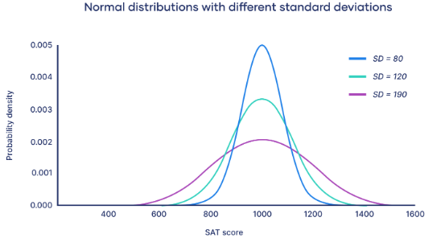
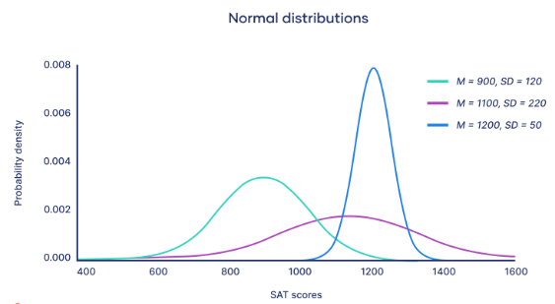
Normal Distribution – Cont.
The figure below shows the a Normal distribution probability function.
The shape and location of the curve changes by changing the figures of Mean & StD.

Slide 31
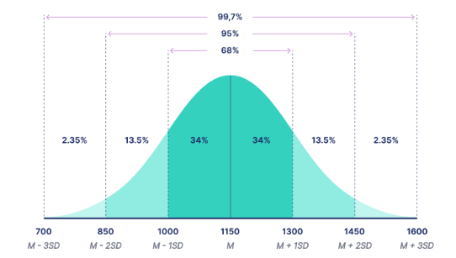
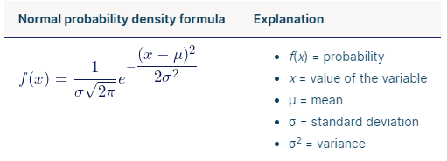
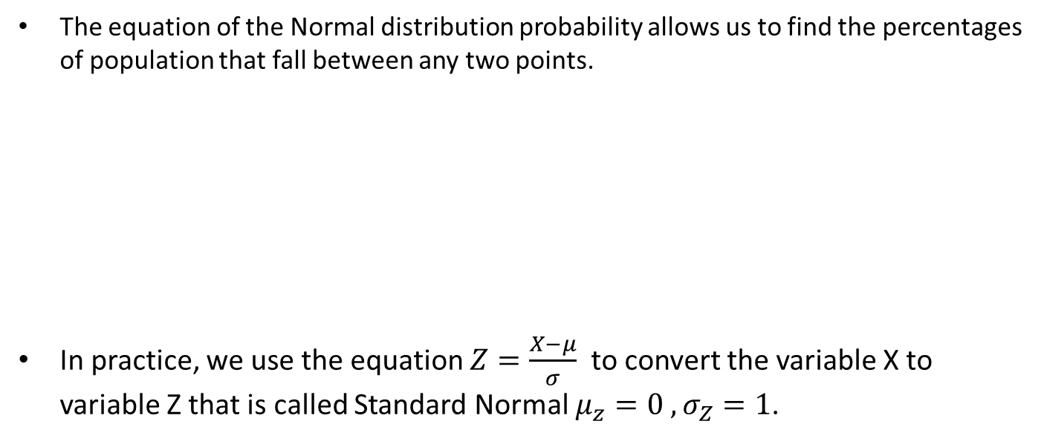
Normal Distribution – Cont.
The equation of the Normal distribution probability allows us to find the percentages of population that fall between any two points.
In practice, we use the equation $Z=\frac{X−μ}{σ}$ to convert the variable X to variable Z that is called Standard Normal $μ_{z}=0 , σ_{Z}=1$.

Slide 32
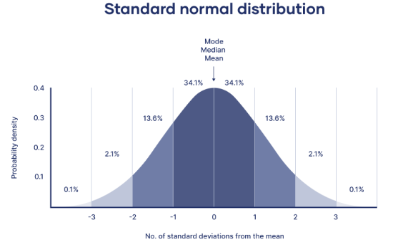
Normal Distribution – Cont.
We can find any probability/percentage/proportion for Normal distribution using tables of various statistics packages.
Furthermore, the mathematics behind many statistical hypothesis tests are based on the assumption that the variable is Normally distributed.
We therefore need to perform the Normality test prior to performing any hypothesis Statistical testing that relies on the Normality assumption.

